Slide 1
The Social Business Ecosystem
Introduction to social technology applied to business: it pulls together the elements of the social business ecosystem profiles, applications, communities and forums, and more, and thereby provides the basis for understanding how to connect current and potential customers with the inner workings of your business or organization, where collaborative processes can take hold and drive long-term benefits.

Slide 2
Social Profiles
At the center of the Social Web and the shared activities that define it are the online personas of participants: More than with prior anonymous discussion boards or cloaked personas, it’s an actual identity that is of value in a business context, since it is generally the motivation of an individual to be noticed as such that drives social participation in the first place.
Though detailed personal information is (still) generally not available except to “trusted friends” or colleagues, the use of a real name or photo in one’s social profile is becoming common.
Along with any optionally provided information, the result is a a basis for understanding who it is that is actually participating.

Slide 3
The Profile as a Social Connector
The role of the social profile as a connector cannot be understated in business applications of social media. Following on the prior discussion, the social profile provides two central social elements, both of which are essential:
A tangible personal identifier around which a relationship can be formed.
A framework for accountability for one’s actions, postings, and roles taken in the relationship that forms.
Taken together, the significance of the profile is its central role in establishing who is participating. When people have that basic information, they will more readily enter into functional relationships and share or transfer useful knowledge.

Slide 4
The Profile and the Social Graph
Its understand that the social graph includes the set of profiles that describe the members of a social network and the interactions, activities, and relationships that connect specific profiles on the Social Web.
In perhaps the simplest view, the social graph defines the way in which one profile is connected to another, through a friendship relationship perhaps.

Slide 5
Social Applications
Taking the four basic building blocks together—consumption, curation, creation, and collaboration one possible model (there are many) for driving engagement emerges.
Engagement can be tapped for marketing purposes by anchoring it within the context of the basic social structures—communities, social applications, and similar—and then connecting these back to your brand, product, or service. In this section, social applications are the focus.
The basic process of engagement begins with content consumption and builds up to collaboration between participants in the creative process. This is the kind of activity that binds community members together.
Taking off on this, there are specific social applications forums, collaborative tools, contests, and games among them that you can implement under your own brand to lead your participants through the steps of engagement that drive your business.

Slide 6
Support Forums
Accepting that social applications are an adjunct to social networks and online communities, the starting set of applications support forums are built around the white-label social technology platforms offered by more than a few software providers. As used here, “white label” means “software application that can be branded to your specification” but is otherwise ready to use.
The platforms may be delivered for internal use on an enterprise appliance, as an SaaS (Software as a Service) delivery, or as licensed software from providers like Lithium Technologies, Cyn.in, or Jive among many others.

Slide 7
Content Sharing
If support forums and similar social applications provide the connections between communities and your business, what is it that is actually shared? This is where the content creation and sharing tools come in. Recall the engagement building blocks consumption, curation, creation, and collaboration.
Sharing first emerges in the curation phase of engagement as people rate the works of others in a public setting.
Content creation is almost universally undertaken specifically for the purpose of sharing.

Slide 8
Purpose-Built Applications
Purpose-built applications—including so-called “widgets”—can provide a very easy way to quickly implement social behavior.
Like communities and social applications in general, these small, purpose-built applications are designed to facilitate specific interactions between community or stakeholders.
In contrast to communities and larger social applications which often have more than modest building costs and longer development cycles purpose-built applications can be created that literally “snap in” and can be fitted and ready for use in days or even hours.

Slide 9
Using Brand Outposts and Communities
It’s time to connect the basics, to put in place the beginning of a framework for a social business. In this chapter the social behaviors described so far are applied in specific social spaces think online communities here where the actual interactions, discussions, and conversations take place.
For most businesses and organizations, the places where customers willingly spend time often engaged in conversation about the business or organization is a social network or online community that is dedicated not to brands, products, or services, but rather to other people like themselves, with interests like their own.
You participate in the activities they are involved in with full disclosure and transparency in order to build the levels of trust that that will elicit their contributions of knowledge back to you.

Slide 10
Cont…
Look at the following list of the typical places where brand outposts are established: In each of these cases, you are going to them.The following are examples of common brand outposts:
Twitter
Second Life Islands
Facebook Business Pages
YouTube Channels

Slide 11
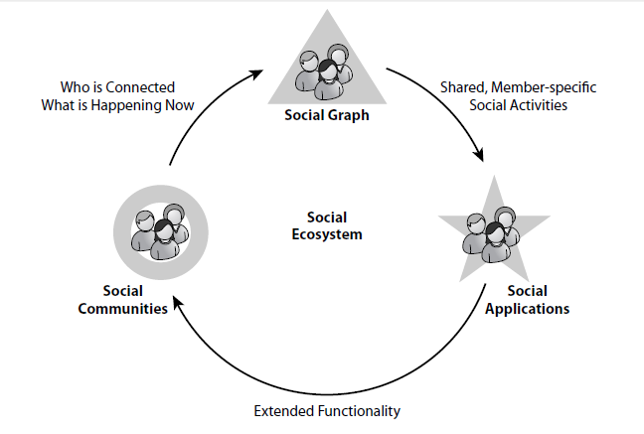
The Social Ecosystem
The social ecosystem, taken as a whole, provides three fundamental opportunities for understanding and leveraging the behaviors associated with collaborative interaction.
These opportunities the social graph, social applications, and social platforms are shown in Figure.

Slide 12
Cont….
Social applications—extensions to the core capabilities of the social platforms and software services that support social networks—provide the additional, specific functionality that makes the larger community and platforms useful to individual participants.
The Aircel voicemail application and Slide’s Top Friends application that extend the functionality of Facebook are examples of social applications.

